Slide 1


ESP-Mesh
Workshop
29 September 2023

Slide 2


About Me

Slide 3

Scan to access materials
2

Slide 4

Introduction to ESP32 Board
1

Slide 5

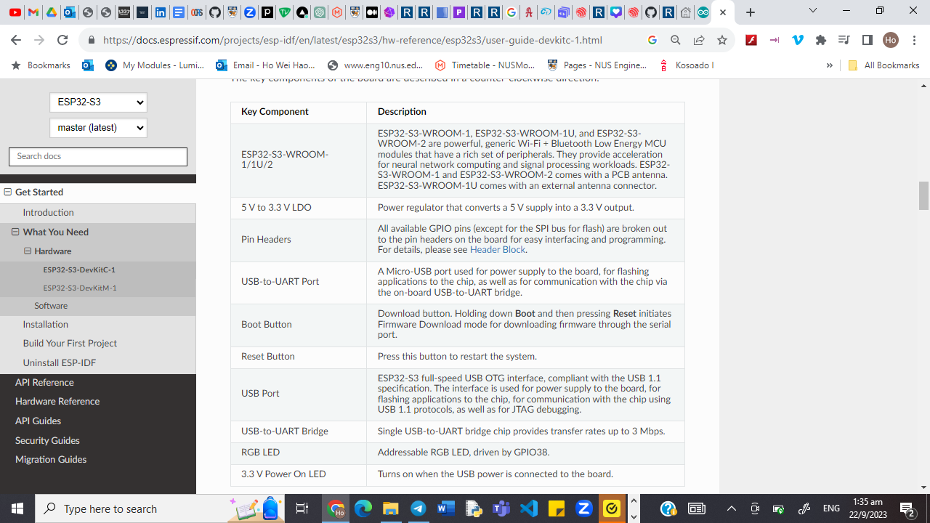
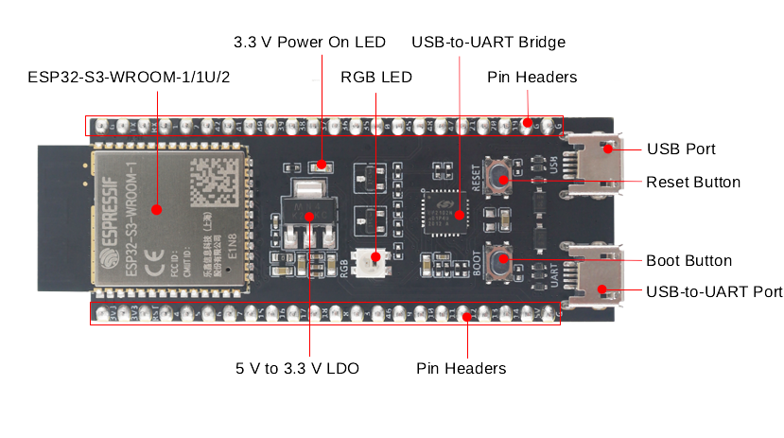
ESP32-S3-DevKitC-1 Board
https://docs.espressif.com/projects/esp-idf/en/latest/esp32s3/hw-reference/esp32s3/user-guide-devkitc-1.html

Slide 6
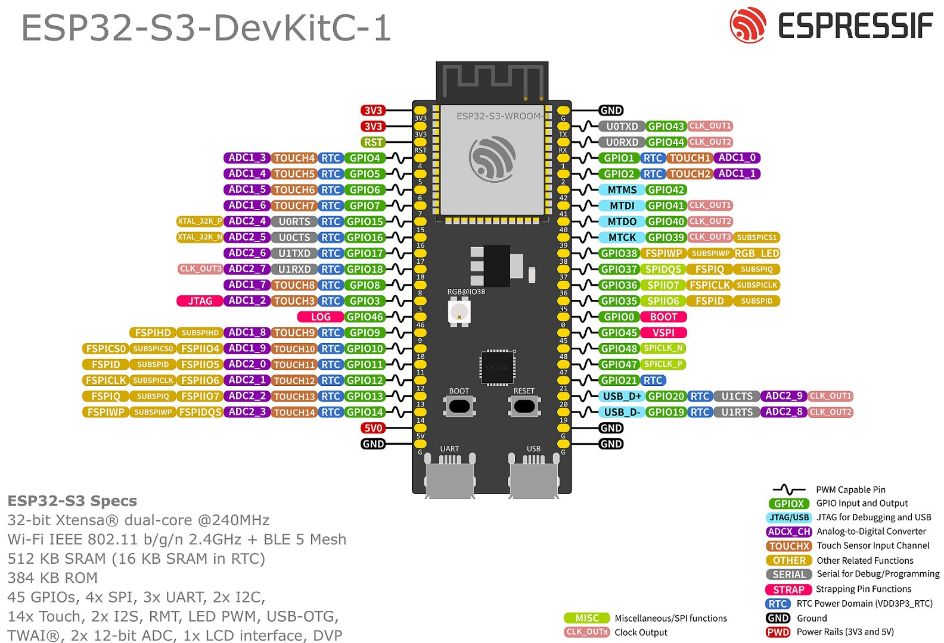
https://docs.espressif.com/projects/esp-idf/en/latest/esp32s3/hw-reference/esp32s3/user-guide-devkitc-1.html

Slide 7
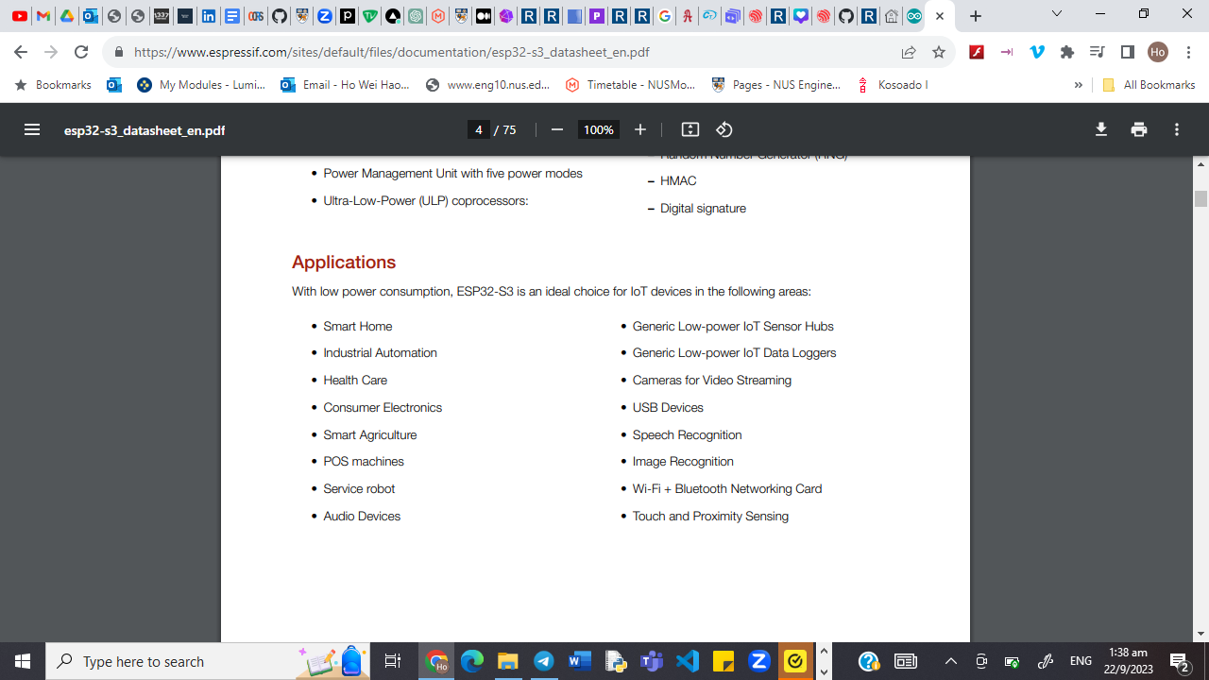
ESP32-S3-DevKitC-1 Board

Slide 8

Introduction to Arduino IDE
2

Slide 9

Arduino IDE
Download IDE from https://www.arduino.cc/en/software
Easily download libraries to use
Flexibility in managing many different boards

Slide 10
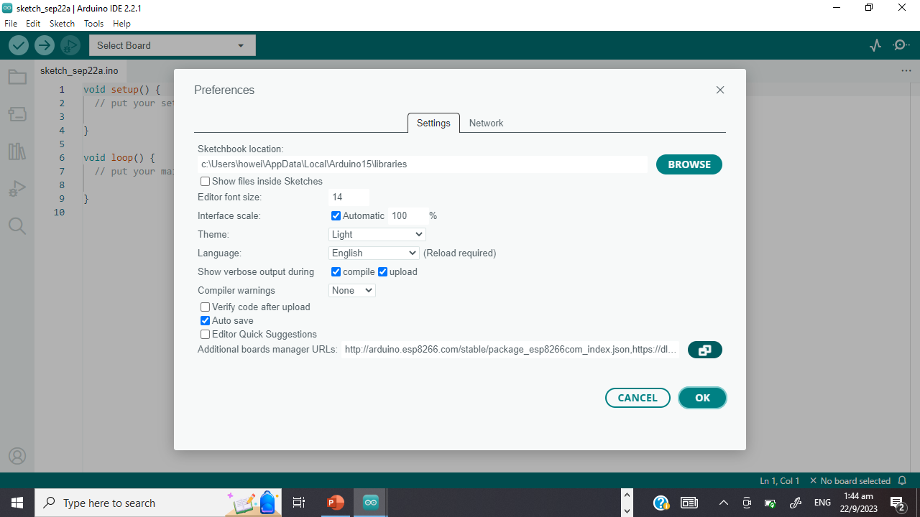

Getting Started
Start up Arduino IDE
Go to Arduino
IDE > Preferences > Additional Boards Manager URLs
and paste the JSON link
https://raw.githubusercontent.com/espressif/arduino-esp32/gh-pages/package_esp32_dev_index.json
https://hutscape.com/tutorials/hello-arduino-esp32s3

Slide 11
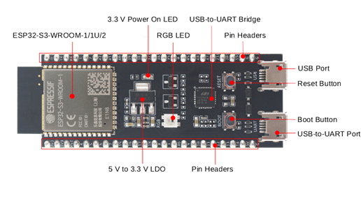
How to Connect to the Board?

Slide 12
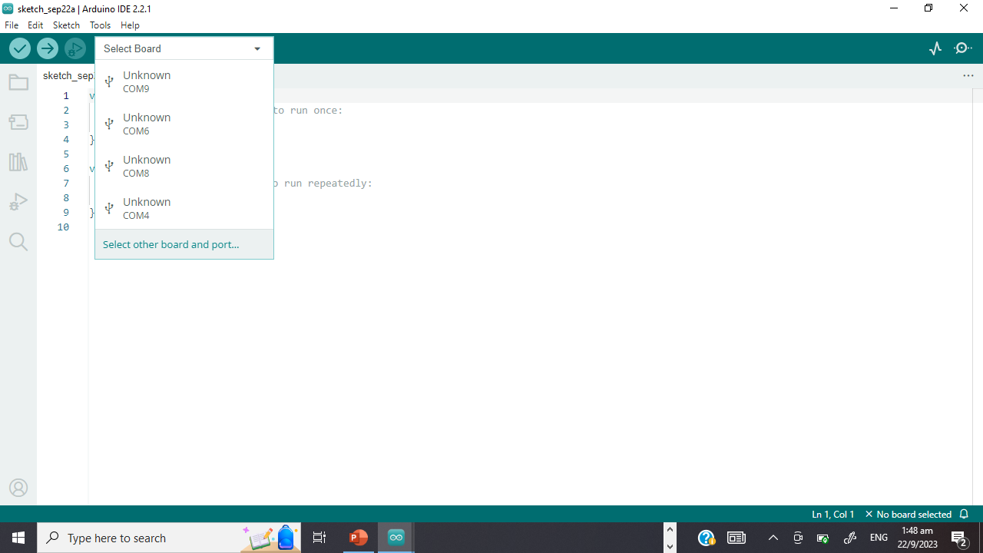
Getting Started
After downloading, connect the board to the UART port (right port)
Select board > other board and port
Choose the board “ESP32-S3-USB-OTG”

Slide 13
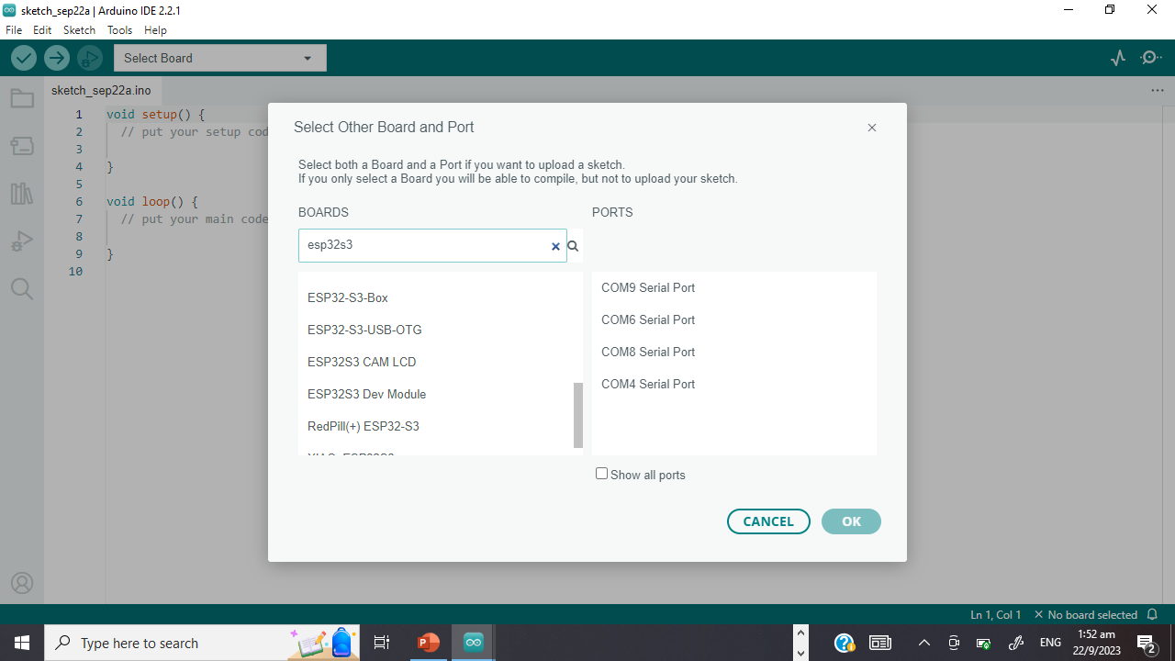
Getting Started
After downloading, connect the board to the UART port (right port)
Select board > other board and port
Choose the board “ESP32-S3-USB-OTG”
Notes:
20

Slide 14

3
Traditional ESP Connection

Slide 15
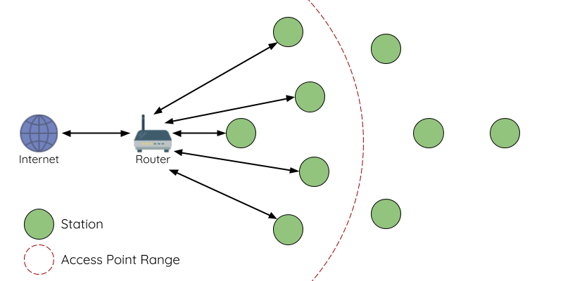
Traditional

Slide 16
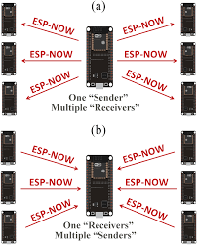
Example: ESP-NOW
“Star” shape
One master, multiple slaves
Without Wifi

Slide 17
Let’s Try It Out!
Flash the now_sender code
https://randomnerdtutorials.com/esp-mesh-esp32-esp8266-painlessmesh/

Slide 18
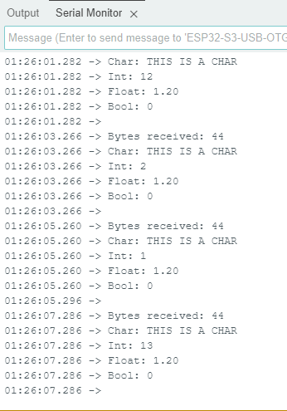
Expected Outcome (Connected)

Slide 19
Try removing one device!
https://randomnerdtutorials.com/esp-mesh-esp32-esp8266-painlessmesh/
Notes:
30

Slide 20
Expected Outcome (Disconnected)

Slide 21

4
ESP-Wifi-Mesh

Slide 22
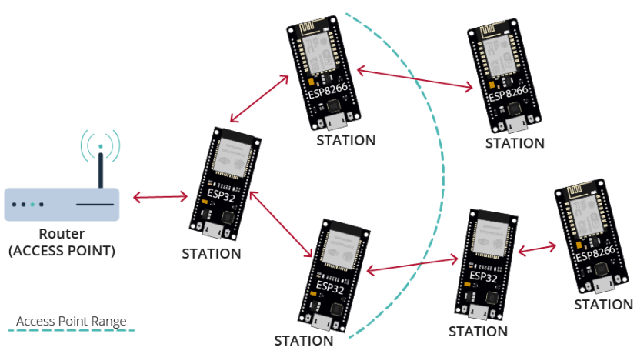
Mesh
https://randomnerdtutorials.com/esp-mesh-esp32-esp8266-painlessmesh/

Slide 23





Why ESP-Mesh?
Self-organizing
Self-healing
Potentially unlimited device pairing
Do not require additional mesh infrastructure to cover wider areas
IP connectivity, access provided by node

Slide 24
Let’s Try It Out!
Notes:
30

Slide 25
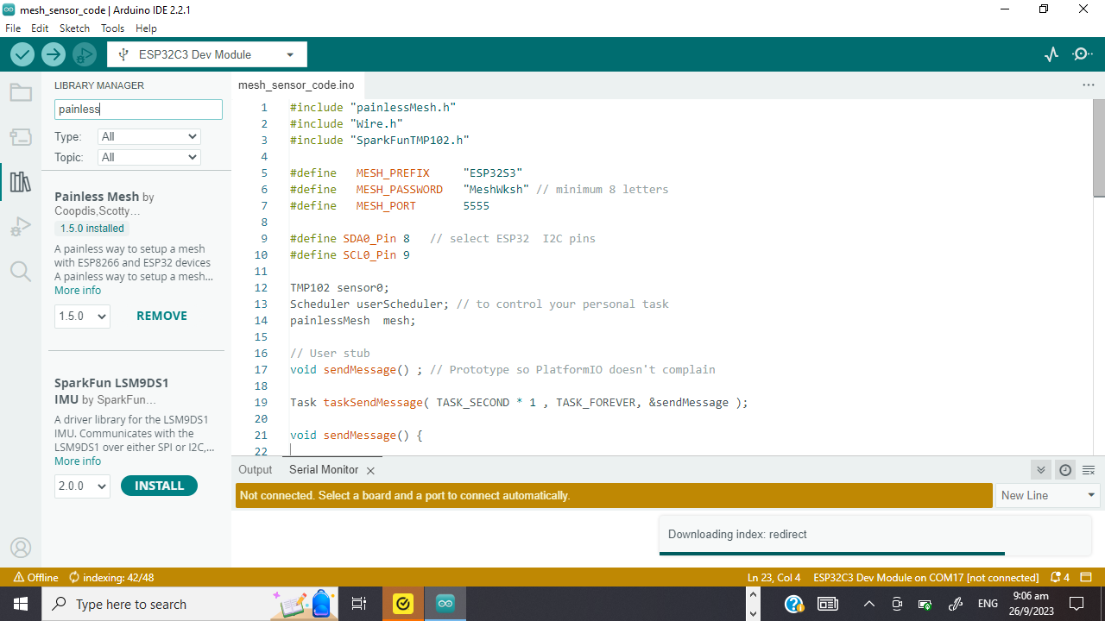
Required Libraries
Painless Mesh
Additional libraries
ArduinoJson (by bblanchon)
TaskScheduler
ESPAsyncTCP (ESP8266)
AsyncTCP (ESP32)

Slide 26
Let’s Try It Out!
Flash the mesh_basic_code
https://randomnerdtutorials.com/esp-mesh-esp32-esp8266-painlessmesh/

Slide 27
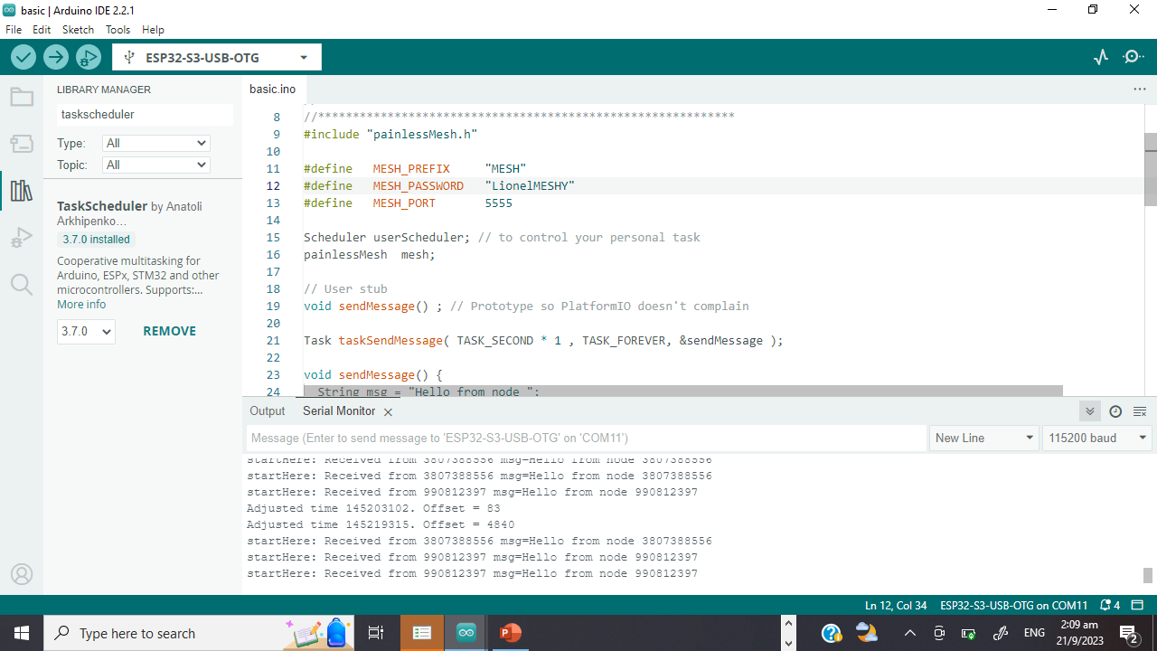
Expected Outcome (Connected)
Boards receive messages from each other
Adjustments in receival time (self-healing)

Slide 28
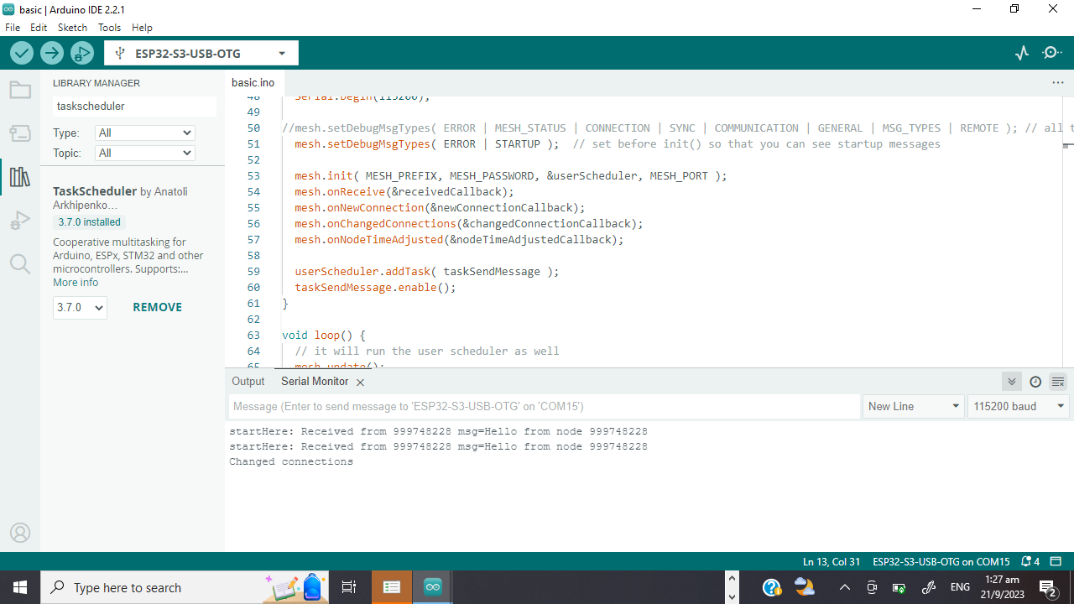
Expected Outcome (Disconnected)
Change connection
Root node selection

Slide 29

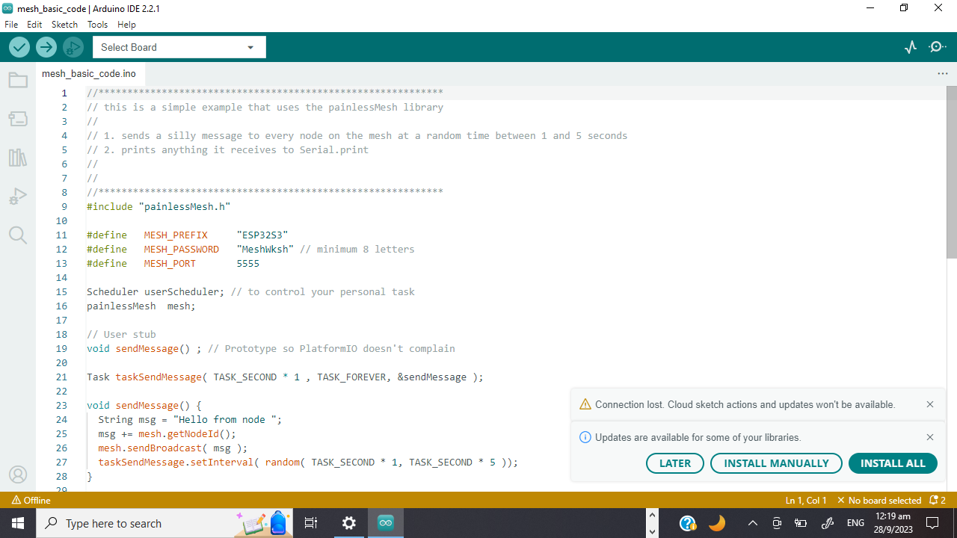
Code Inspection
“Username” and “password”
Can be altered to your choice
Notes:
20

Slide 30
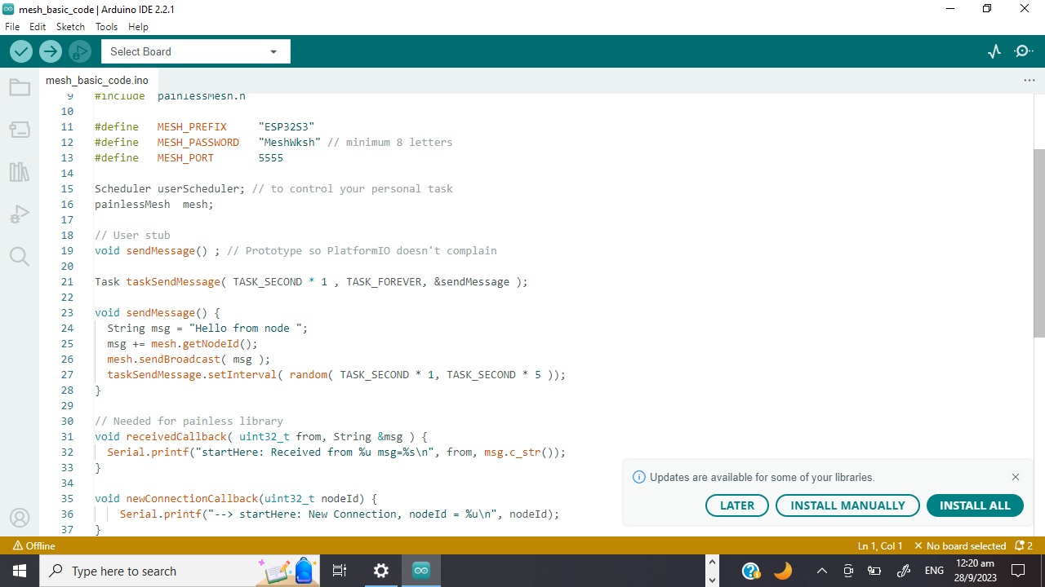
Code Inspection
Recommended to avoid using delay() in the mesh network code.
Delay() will stop background tasks and can cause the mesh to lose stability/fall apart.

Slide 31
Code Inspection
Constructs and sends a message
Queries for chip ID
Choose random time interval to send another message

Slide 32
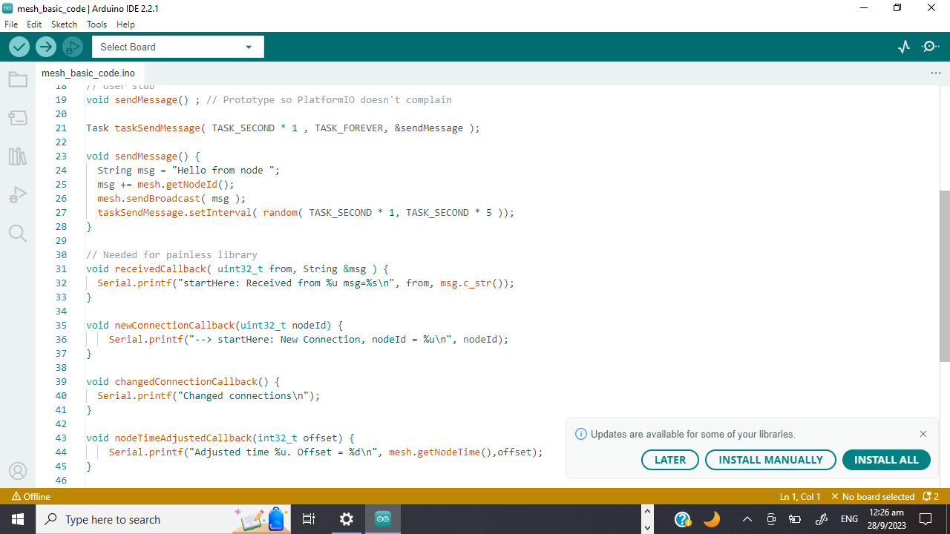
Code Inspection
Checks for any message received
Prints message

Slide 33
Code Inspection
Runs when a new node joins
Potential for other functionality

Slide 34
Code Inspection
Runs when a node joins or leaves
Potential for other functionality

Slide 35
Code Inspection
Runs when network adjusts time to synchronise all nodes

Slide 36
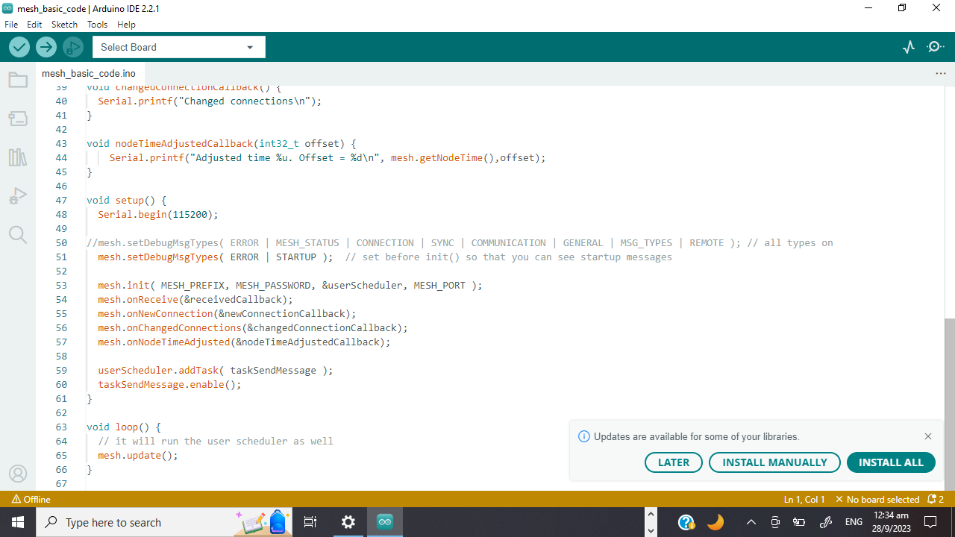
Code Inspection
Set error message type
Initialise mesh
Assign callback functions to corresponding events
Add tasks to scheduler which keep tracks of the time

Slide 37
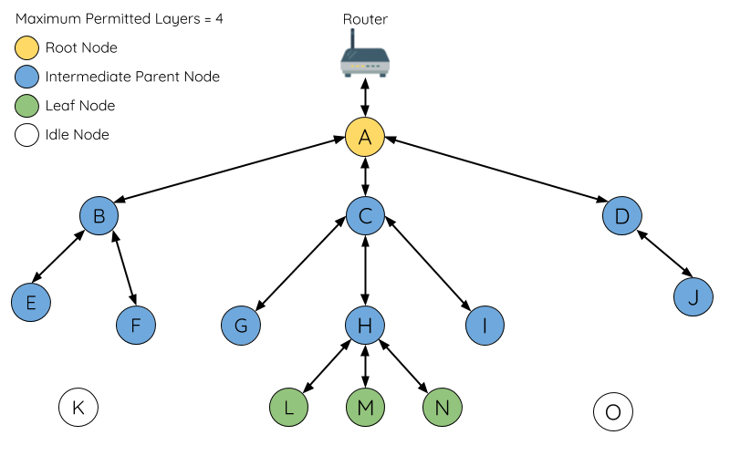
ESP-Mesh Topology

Slide 38

Forming the Mesh
Every node periodically transmits Wi-Fi beacon frames
Idle nodes listen for beacon frames to generate a list of potential parent nodes,
If a beacon frame with an RSSI is below a preconfigured threshold, the transmitting node will be disregarded when forming an upstream connection.
https://docs.espressif.com/projects/esp-idf/en/stable/esp32/api-guides/esp-wifi-mesh.html

Slide 39
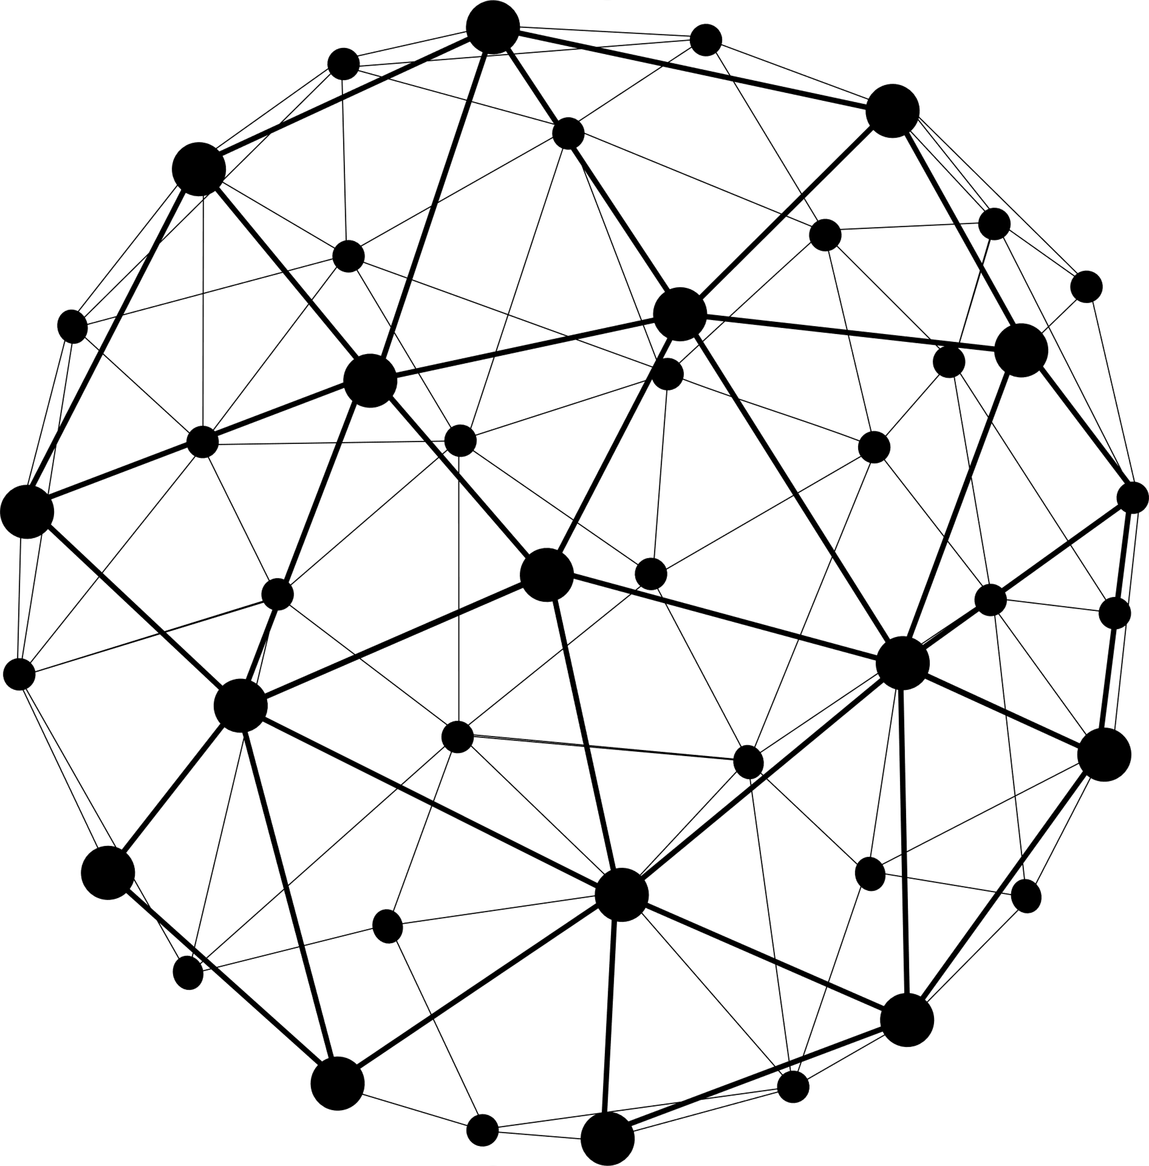
Forming the Mesh
Idle node will form an upstream connection with the preferred parent node.
Determined based on (1) parent node layer and (2) number of child nodes
https://docs.espressif.com/projects/esp-idf/en/stable/esp32/api-guides/esp-wifi-mesh.html

Slide 40

Root Node Selection (Election Process)
Scans for beacon frames from other nodes.
Votes for nodes with a beacon frame with a stronger router RSSI
Individually check for its vote percentage
If a node has a vote percentage larger than a preconfigured threshold (90% by default), the node will become a root node.
https://docs.espressif.com/projects/esp-idf/en/stable/esp32/api-guides/esp-wifi-mesh.html

Slide 41

Network Management
Root Node Failure
Intermediate Parent Node Failure
Root Node Switching
Parent Node Switching
https://docs.espressif.com/projects/esp-idf/en/stable/esp32/api-guides/esp-wifi-mesh.html

Slide 42
5
APPLICATIONS
You could enter a subtitle here if you need it
Notes:
30

Slide 43
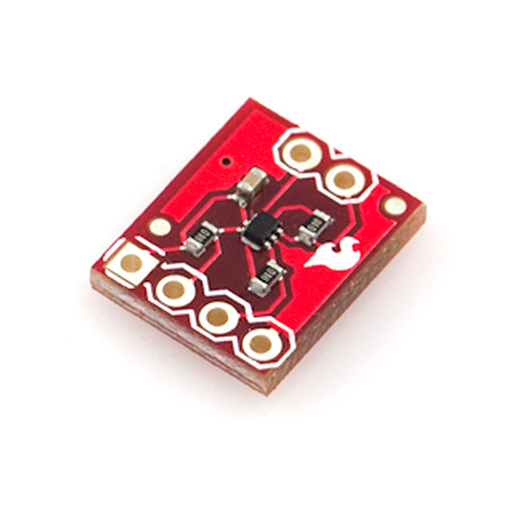
Temperature Monitoring Project
TMP102 breakout board
Input 3V3
Supports I2C

Slide 44
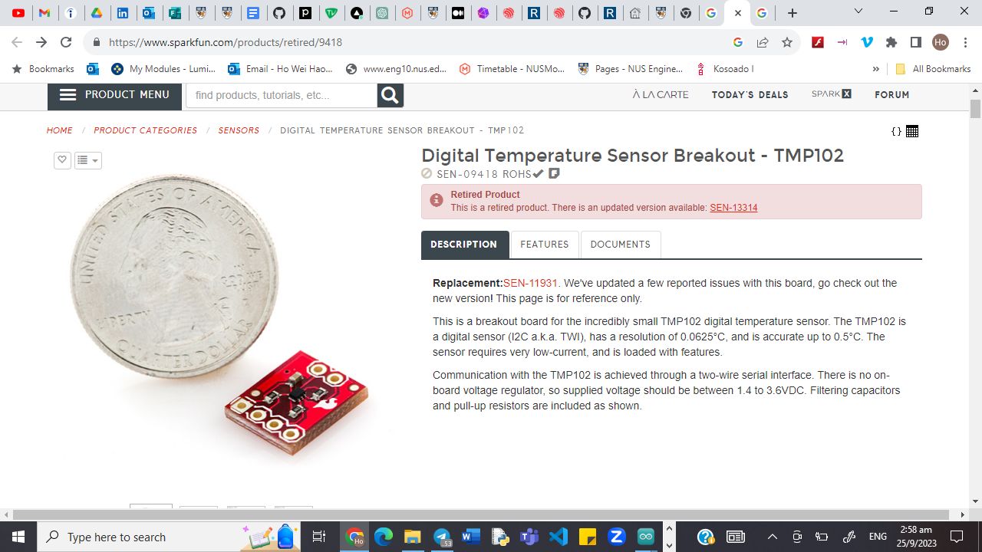

Slide 45
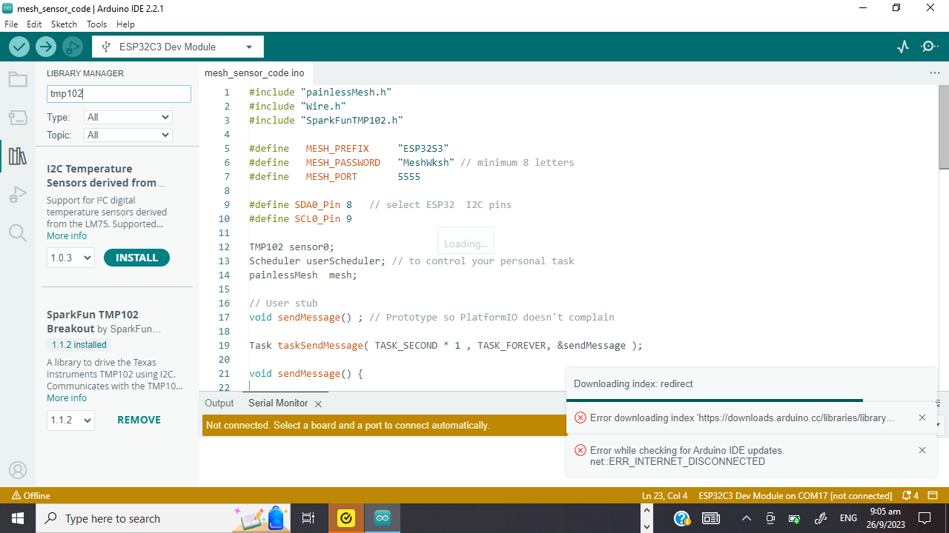
Libraries
SparkFun TMP102 Breakout
To read sensor data

Slide 46
Let’s Try It Out!
Connect the esp32 to the sensor
https://randomnerdtutorials.com/esp-mesh-esp32-esp8266-painlessmesh/

Slide 47
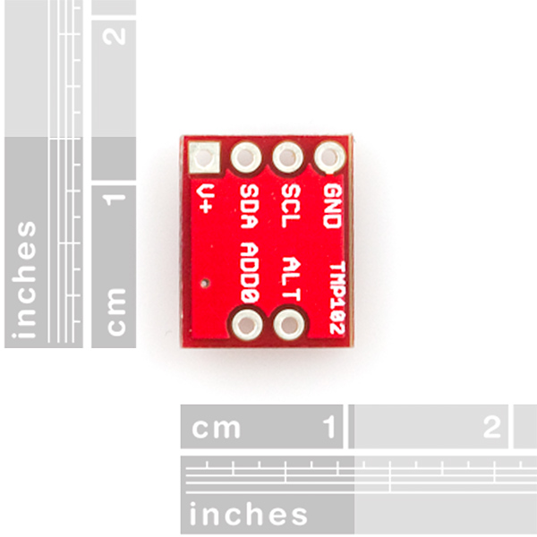
Wiring
https://docs.espressif.com/projects/esp-idf/en/latest/esp32s3/hw-reference/esp32s3/user-guide-devkitc-1.html

Slide 48
https://docs.espressif.com/projects/esp-idf/en/latest/esp32s3/hw-reference/esp32s3/user-guide-devkitc-1.html

Slide 49
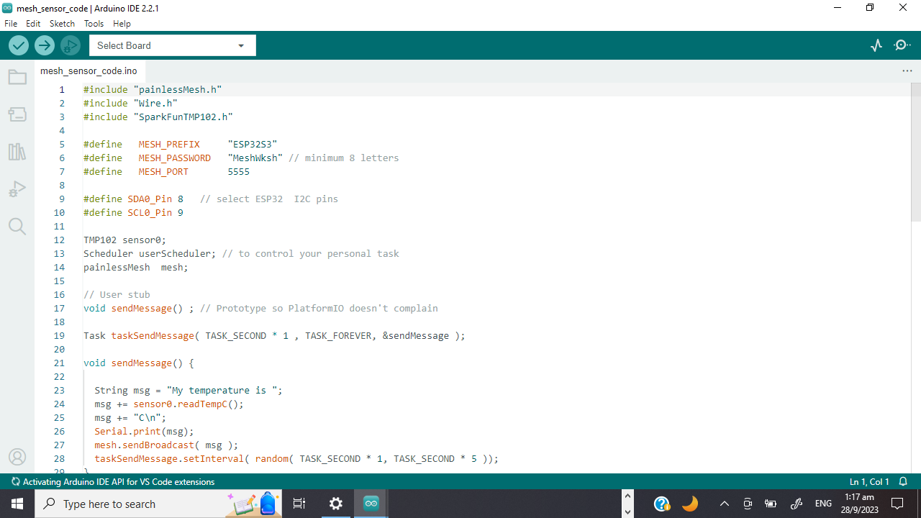

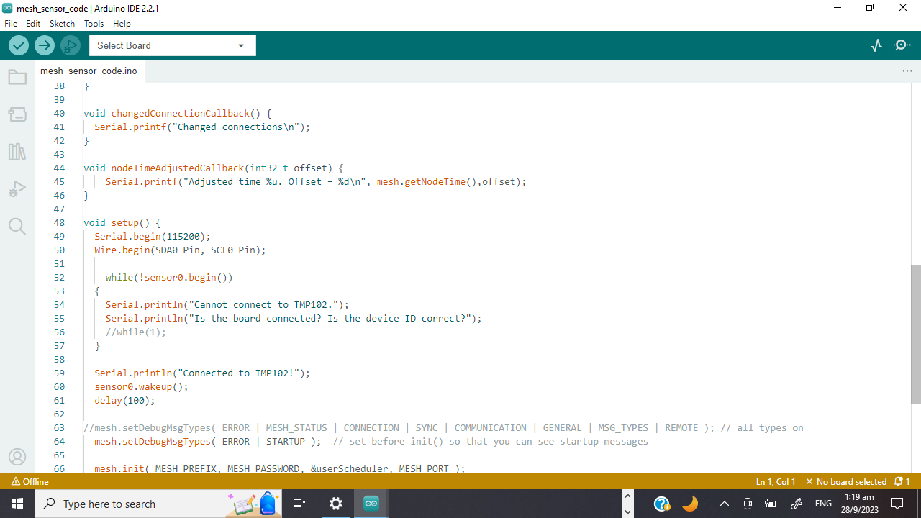
Code Inspection

Slide 50
Let’s Try It Out!
Flash the mesh_sensor_code

Slide 51
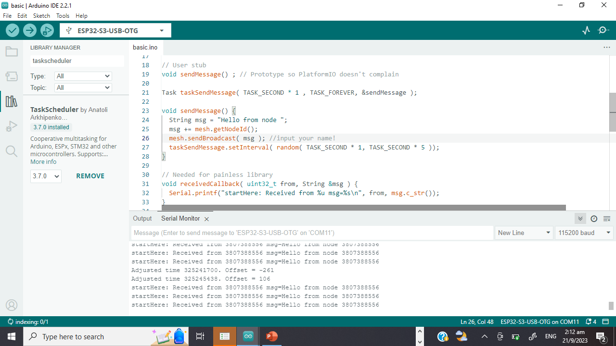
Code Inspection
Read the data from the sensor
Compile data into the message

Slide 52
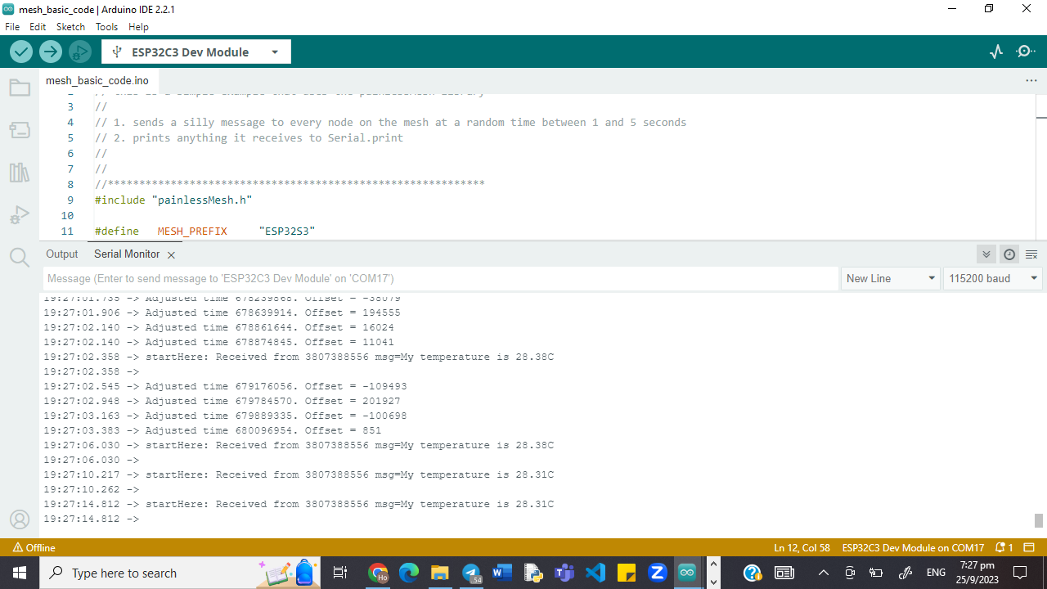
Expected Outcome (Connected)

Slide 53

Potential Projects

Slide 54



THANKS!
Do you have any questions?
e0774750@u.nus.edu
https://www.linkedin.com/in/ho-wei-hao/
Feel free to contact me for hackathon, project etc. collaborations!

